Slide 1
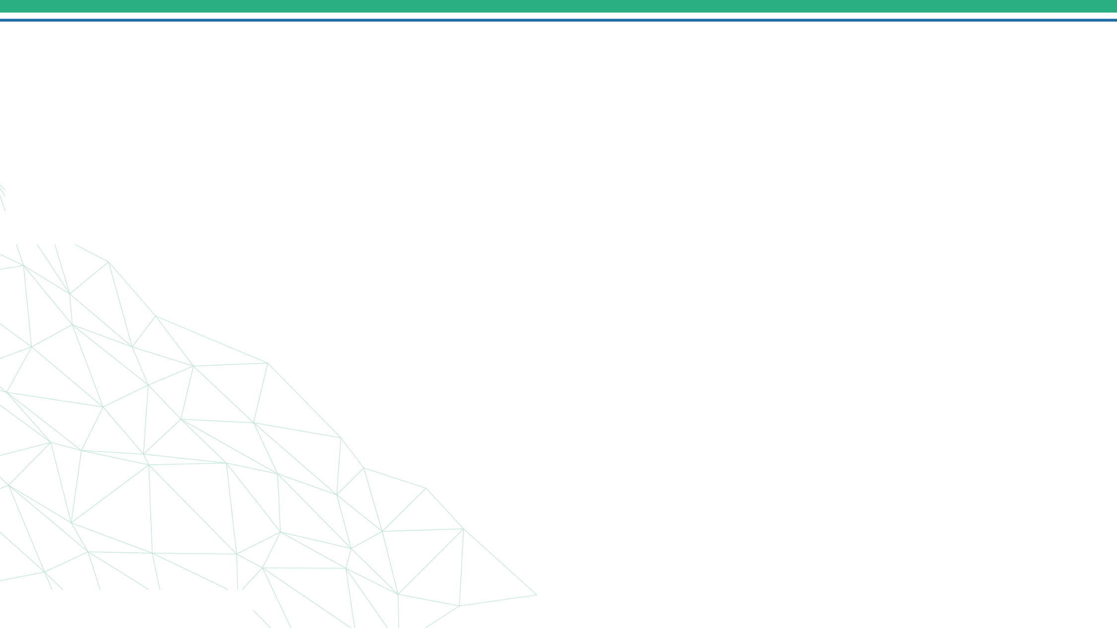



Eventify
Booking Venues And Organizing Events Platform
09/5/2025
1
Notes:
1.7.2013
‹#›

Slide 2
Team Members
    Zyad Gamal Hassan Bash (Team Leader)
    Fares Hassan Ali Eldagen
    Ahmed Elsayed Mohamed Elbatrawy
    Amr Elsaed Mohamed Musbah
09/5/2025
2
Notes:
1.7.2013
‹#›

Slide 3
Problem Statement
    Organizing events such as seminars, conferences, concerts, and workshops often faces significant challenges.
    Venue owners struggle to effectively showcase and manage the availability of their spaces, while event organizers waste time searching for suitable locations that meet their needs.
    This fragmentation creates inefficiencies, reduces accessibility, and hinders the overall event experience for all stakeholders.
09/5/2025
3
Notes:
1.7.2013
‹#›

Slide 4
User Story : Venue Owner
1 - Manage Venue Profile
As a Venue Owner, I want to add and edit my venue details so that customers can find accurate information.
2 - Receive Booking Requests
As a Venue Owner, I want to receive event booking requests so that I can review them before confirmation.
3 - Accept / Reject Event Requests
As a Venue Owner, I want to approve or reject booking requests so that I can control availability and scheduling.
4 - Receive Payments
As a Venue Owner, I want to receive rental payments directly to my account so that I can earn revenue securely.
09/5/2025
4
Notes:
1.7.2013
‹#›

Slide 5
User Story : Event Organizer
1 - Browse Venues
As an Event Organizer, I want to browse venues so that I can find the right place for my
event.
2 - Filter & Search
As an Event Organizer, I want to filter venues by capacity, price, and location so that I can easily find a suitable venue.
3 - Book a Venue
    As an Event Organizer, I want to submit a booking request so that I can reserve the venue for my event.
4. Set Event Details & Pricing
    As an Event Organizer, I want to set event details and ticket pricing so that attendees understand the event.
09/5/2025
5
Notes:
1.7.2013
‹#›

Slide 6
User Story : Admin
1 - Review Venues
  As an Admin, I want to review newly submitted venues so that I can approve only valid and trusted listings.
2 - Approve / Reject Venues
  As an Admin, I want to approve or reject venue submissions so that only compliant venues appear to users.
3 - Review Events
As an Admin, I want to review event requests so that I ensure events meet platform policies.
09/5/2025
6
Notes:
1.7.2013
‹#›

Slide 7
User Story : Admin
4 - Approve / Reject Events
  As an Admin, I want to approve or reject event requests so that only verified events go live on the platform.
5 - Delete Users
  As an Admin, I want to delete or disable user accounts so that I can remove users who violate platform rules or pose security risks.
09/5/2025
6
Notes:
1.7.2013
‹#›

Slide 8
Database Design
Relational database using Microsoft SQL Server, managed via Entity Framework Core.
Key Features Addressing User Needs (Events/Venues Application)
Events: Linked to Venue (many-to-one); linked to EventPhotos (one-to-many) and Payments (one-to-many). Stores essential details like Date, Description, Category, and Status.
Venues: Contains location details such as Address, City, State, and Capacity; linked to Events (one-to-many) and VenuePhotos (one-to-many).
Payments: Linked to Events (one-to-one); stores the payment ID, Amount, Reference, and EventName.
AspNetUsers (User): Managed via ASP.NET Identity, with roles (via AspNetRoles) to handle permissions. This is the central entity linked to user-specific data like profile details and login information.
EventPhotos / VenuePhotos: Stores visual content related to the main entities, linked to Events and Venues with a (one-to-many) relationship.
AspNetRoles: Used to manage and organize user permissions and access levels (e.g., Customer, Admin, Seller), linked to AspNetUsers through the AspNetUserRoles junction table.
Data Flow: Data collected via user inputs (e.g., event creation, venue booking) on Razor Pages; stored in SQL Server using EF Core; accessed through Repository Pattern with Unit of Work ensuring atomic transactions.
09/5/2025
7
Notes:
1.7.2013
‹#›

Slide 9
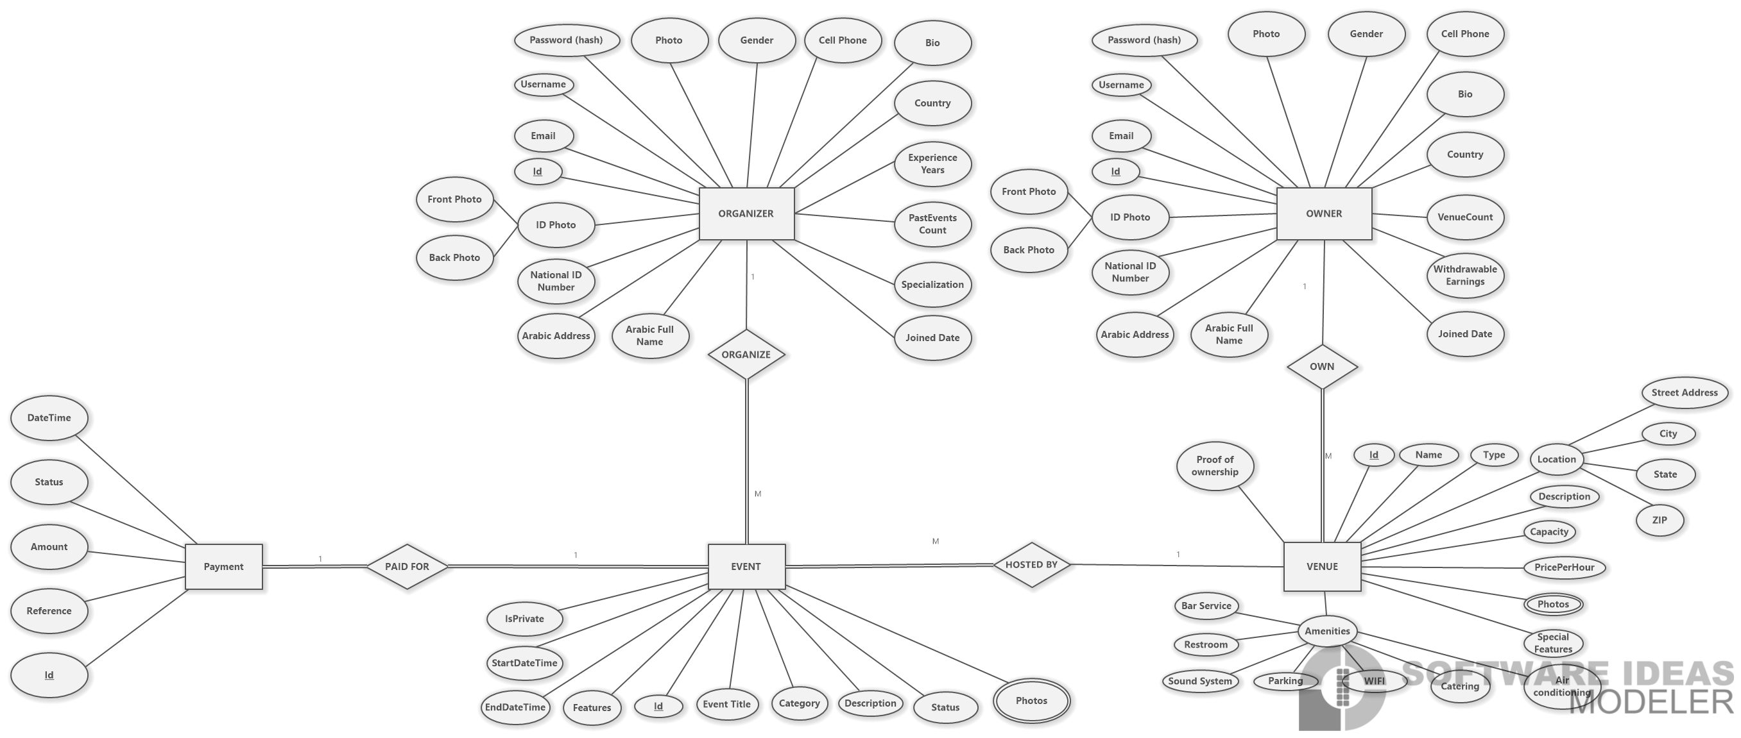
ER Diagram
09/5/2025
5
8
Notes:
1.7.2013
‹#›

Slide 10
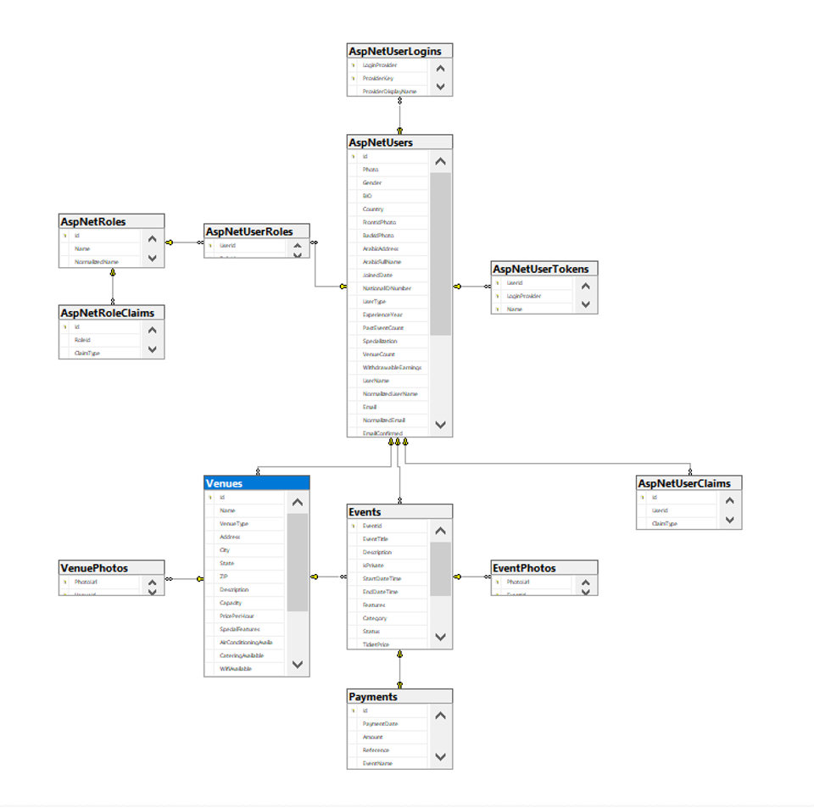
Database Diagram
09/5/2025
9
Notes:
1.7.2013
‹#›

Slide 11
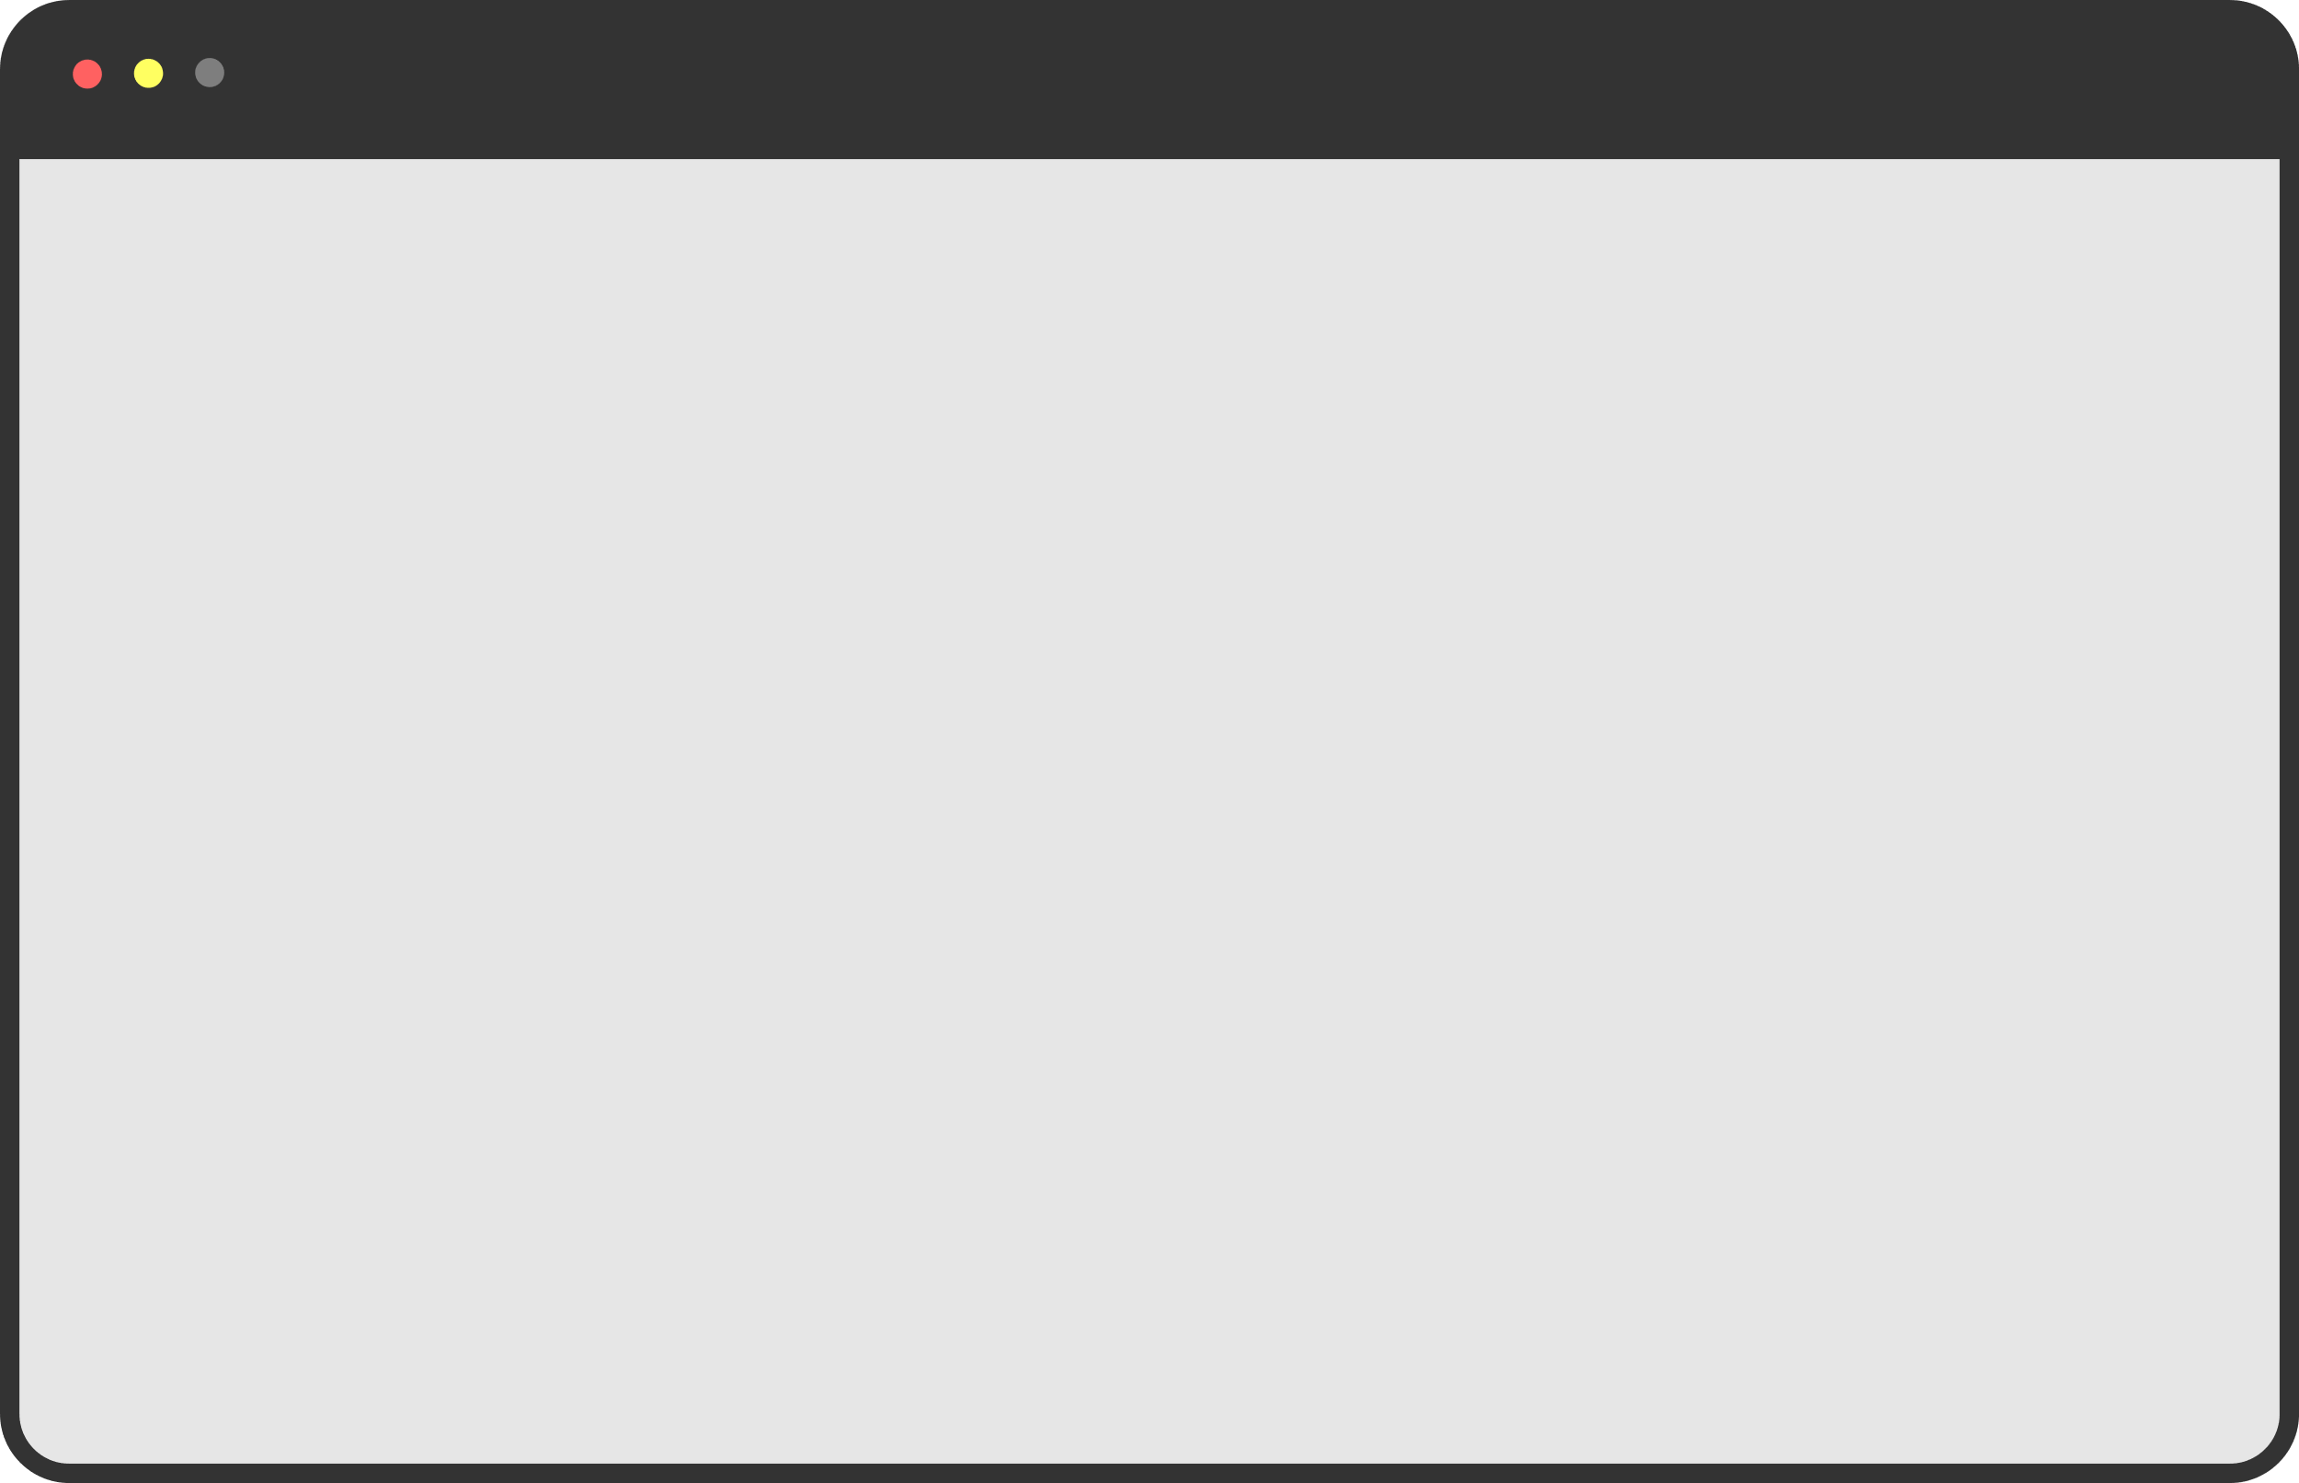

Software Architechture
MVC & 3 tire archtechure
Presentation Layer | Business Logic Layer | Data Access Layer
Controllers Views | Services | Entities Repositories
Entity
DTO
View Model
Browser
DTO
Entity
09/5/2025
10
Notes:
1.7.2013
‹#›

Slide 12
Design Patterns Used
1. Unit of Work Pattern
  Description: Groups related changes into a single transaction to ensure consistency.
  Implementation: The UnitOfWork coordinating multiple repository operations in a single save.
  Purpose: Prevents data inconsistency and handles commit/rollback operations across multiple changes.
2. Repository Pattern
  Description: Abstracts data access logic from the business logic.
  Implementation: Uses generic and specific repositories (e.g., ProductRepository, CategoryRepository) to manage CRUD operations.
  Purpose: Provides a clean API to access the database and promotes reusable, testable code.
3. Dependency Inversion
  Description: Injects services (like repositories or business logic) into controllers.
  Implementation: Built-in ASP.NET Core DI container is used.
  Purpose: Promotes loose coupling, testability, and flexibility in managing dependencies.
09/5/2025
11
Notes:
1.7.2013
‹#›

Slide 13
Authentication & Authorization
The platform uses ASP.NET Identity to implement a secure, role-based authentication system.
Features:
  User Registration and Login
    New users can register using a form.
    Users can securely log in using their email and password .
    Passwords are hashed and stored securely via ASP.NET Identity.
  Role-Based Access
    Three main roles are defined:
      Owner
      Organizer
      Admin
    After logging in, access to different parts of the site is controlled based on the user’s role.
  Authentication Storage
    Authentication state is managed using cookies, managed by ASP.NET Identity.
    The login session persists across the platform until the user logs out or the session expires.
09/5/2025
12
Notes:
1.7.2013
‹#›

Slide 14
Programming Languages + Frameworks
Main Programming Languages Used:
    C# for backend logic in Razor Pages.
    JavaScript for frontend interactivity.
Highlight Frameworks/Tools Used
    ASP.NET Core Razor Pages for page-based web development.
    Entity Framework Core for ORM and database access.
    ASP.NET Identity for authentication and role management.
    jQuery and DataTables for dynamic admin interfaces.
Technologies:
    Stripe API for payment integration.
    Bootstrap for responsive UI design.
09/5/2025
13
Notes:
1.7.2013
‹#›

Slide 15
Functional Requirements
1 – Venue Owner Features
  Venue Management
    Add new venue listings.
    Edit venue details (name, type, location, capacity, amenities).
    Upload and manage venue photos.
  Booking Control
    Receive booking requests from event organizers.
    Accept or reject event booking requests.
    Automatically prevent double booking.
  Calendar (Read-Only Booked Dates)
    View a calendar that displays all booked dates and times only.
    Identify busy days and upcoming confirmed bookings.
    No editing or adding availability—calendar is display-only based on approved requests.
  Payment Handling
    Receive rental payments directly.
    View complete payment history for all bookings.
09/5/2025
14
Notes:
1.7.2013
‹#›

Slide 16
Functional Requirements
2 – Event Organizier Features
  Venue Search
    Browse and explore available venues.
    Filter venues by price, capacity, location, and availability.
    View venue photos, descriptions, and facilities.
  Event Booking
    Create event booking requests for a selected venue.
    Enter full event details: name, date, time, and description.
    Receive notifications when the venue owner accepts or rejects the booking.
  Booking Management
    View history of all submitted booking requests.
    Track the approval status of each event request.
09/5/2025
15
Notes:
1.7.2013
‹#›

Slide 17
Functional Requirements
2 – Admin Features
User Management
  View all users.
  Delete or deactivate user accounts.
  Manage user roles (Admin, Venue Owner, Organizer).
Venue Monitoring
  View all submitted venues.
  Approve or reject venue listings.
  Remove venues that violate platform rules.
Event Monitoring
  View all event requests.
  Approve or reject event listings.
  Remove any event that violates policies.
Platform Oversight
  Access system activity logs.
  Monitor overall performance and usage statistics.
09/5/2025
15
Notes:
1.7.2013
‹#›

Slide 18
Event Status
  Pending
    The event has been created but is waiting for review or initial approval by an administrator or venue manager.
  Approved
    The event details and requested venue have been confirmed and the event is set to proceed.
  Rejected
    The event details were found to be invalid or unacceptable , and the event will not proceed.
  Finished
    The date and time for the event have passed, meaning the event has concluded.
  Paid
    All necessary fees and payments related to the event (e.g., venue booking, payment for tickets) have been successfully processed and confirmed.
09/5/2025
16
Notes:
1.7.2013
‹#›

Slide 19
Timeline for Deliverables:
Milestone 1: Database ERD & Mapping and Initial Setup
Milestone 2: Authentication, Authorization, and User Roles Setup
Milestone 3: Core Functionality (Event Creation, Venue Booking, Status Management)
Milestone 4: Payment Integration and Atomic Transactions Implementation
Milestone 5: Admin Panel, DataTables Integration, Final Testing & Deployment
09/5/2025
17
Notes:
1.7.2013
‹#›

